Slide 1
Machine Learning with Membership Privacy using Adversarial Regularization
Paper By: Milad Nasr, Reza Shokri, Amir Houmansadr
Presented by: Jordan Grewe

Slide 2
Abstract

Slide 3
Privacy Risks in Machine Learning
Machine learning models can leak information about their training data through predictions.
This poses significant privacy risks for users of machine learning as a service.
Goal: Protect user privacy when using machine learning services.

Slide 4
Proposed Privacy Mechanism
Membership Privacy: Ensures predictions on training data are indistinguishable from non-training data.
Formulated as a min-max game:
Minimizes model’s prediction loss.
Limits attackers' ability to infer membership.
Adversarial training strategy implemented.

Slide 5
Practical Feasibility
Evaluated on deep neural networks with benchmark datasets.
Results:
Drastically reduces membership inference attack success (near random guess).
Maintains high model accuracy (less than 4% drop).

Slide 6
Introduction

Slide 7
The Rise of Machine Learning
Factors driving adoption:
Large datasets and advanced computing infrastructure.
Availability of MLaaS (Machine Learning as a Service) platforms.
Challenge: Ensuring data privacy for sensitive training datasets when models are deployed via prediction APIs.

Slide 8
Privacy Concerns in ML Models
ML models can leak sensitive information about training datasets.
Adversaries can exploit model outputs to perform membership inference attacks:
Identify whether specific data points were part of the training set.
These attacks can compromise privacy, even in black-box settings.

Slide 9
Existing Approaches
Limiting predictions (e.g., top-k predictions):
Reduces precision but provides weak privacy guarantees.
Regularization techniques (e.g., L2-norm):
Limits overfitting but doesn’t ensure rigorous privacy protection.
Differential privacy mechanisms:
Guarantees privacy for all possible neighboring datasets but impacts utility.

Slide 10
Contributions of This Work
Proposes a rigorous privacy mechanism for ML models:
Ensures membership privacy by making predictions indistinguishable between training and non-training data.
Achieves privacy with minimal classification loss.
Formalizes the problem as a min-max privacy game:
Balances model utility and privacy protection.

Slide 11
Goals of the Proposed Mechanism
Minimize classification error while defending against the strongest inference attack.
Train the model using an adversarial process:
Uses inference attack as a regularizer to ensure privacy.
Ensures membership inference success is no better than random guessing.

Slide 12
Machine Learning

Slide 13
Focus on Supervised Learning
The goal of supervised learning:
Map input features 𝑋 to output labels 𝑌.
Classification models:
Predefined set of 𝑘 classes.
Objective: Accurately classify each data point into its corresponding class.

Slide 14
Objective of Machine Learning
Aim: Minimize the difference between the model’s predictions 𝑓(𝑥) and the true labels 𝑦.
Training process:
Uses samples drawn from the joint probability distribution 𝑃𝑟(𝑋,𝑌).
Training set: 𝐷⊆𝑋×𝑌.

Slide 15


Loss Function and Optimization
The loss function 𝐿(𝑓):
Measures the error between predictions 𝑓(𝑥) and true labels 𝑦.
Objective: Minimize the expected loss 𝐿(𝑓).
Practical implementation: Minimize empirical loss 𝐿_{𝐷}(𝑓) on the training set.

Slide 16
Regularization
Regularization function 𝑅(𝑓):
Prevents overfitting by penalizing overly complex models.
Optimization problem:
Balances accuracy and model generalization.

Slide 17
Training Process
Common algorithm: Stochastic Gradient Descent (SGD).
SGD iteratively updates model parameters using mini-batches of data:
Reduces empirical loss.
Converges to a local minimum of the loss function.

Slide 18
Membership Inference Attacks
(Tracing Attacks)

Slide 19
What are Membership Inference Attacks?
Objective:
Determine whether a target data record is part of a dataset 𝐷.
How it works:
Adversary observes computations over 𝐷 (e.g., ML model predictions, aggregate statistics).

Slide 20
Challenges in Black-box Settings
Inference attacks on ML models require distinguishing:
Training set members vs. non-members.
Based on differences in model predictions.
Adversaries may use likelihood ratio tests or statistical comparisons.

Slide 21
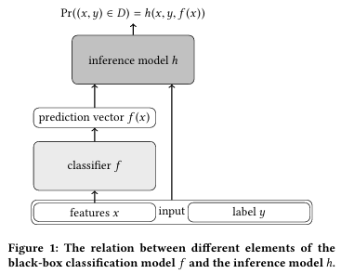
Inference Model Design
Inference Model ℎ:
Outputs probability of a data record belonging to the training set 𝐷.
Inputs: Feature vector 𝑥, label 𝑦, and prediction vector 𝑓(𝑥).

Slide 22

Inference Gain
Definition: Measures how well h distinguishes members from non-members.
Objective: Maximize G _{f,D}A _{,D}’A (h).

Slide 23
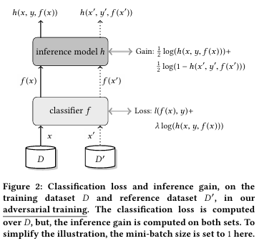
Classification Loss and Inference Gain
Classification Loss: Measures the model's prediction error on the training dataset 𝐷.
Inference Gain: Quantifies how well the inference model ℎ distinguishes between members and non-members in 𝐷.

Slide 24

Optimization Problem
Goal: Solve
Requires training h on:
Same model type and architecture as f.
Data sampled from Pr(X,Y), matching f’s training data.

Slide 25
Key Takeaways
Membership inference attacks exploit small differences in model predictions.
The black-box setting adds complexity:
Adversaries adapt to the model to maximize their inference success.

Slide 26
Min-Max Membership Privacy Game

Slide 27
The Adversarial Privacy Problem
Key Idea:
Adversary optimizes inference attacks to maximize their gain.
Defender must anticipate the strongest attack and mitigate it.
Challenge:
Defenses designed for specific attacks can fail when adversaries adapt.

Slide 28
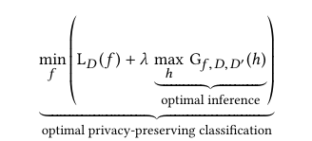
Privacy Game Formulation
Core Equation:
Purpose:
Balance utility (accuracy) with privacy (low inference success)

Slide 29
Adversarial Training Algorithm
Overview:
Alternating optimization process:
Maximization Step: Update inference model ℎ to increase its gain.
Minimization Step: Update classifier 𝑓 to reduce loss and counteract ℎ.
Iterates until equilibrium is reached.
Algorithm Workflow:
Input: Training dataset 𝐷 and disjoint reference set 𝐷′.
Output: Privacy-preserving classifier 𝑓.

Slide 30
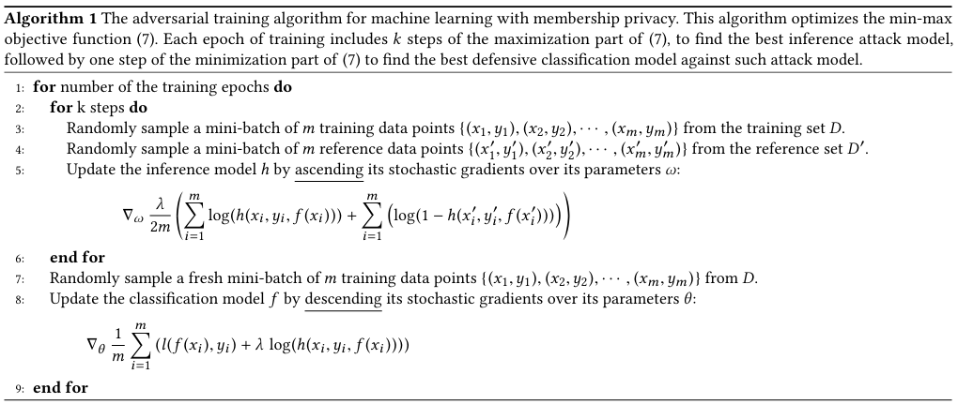

Slide 31

Theoretical Insights
Optimal Solution: the inference model h* pushed adversary to random guess accuracy

Slide 32
Role of Regularization
Regularization Mechanism:
Penalizes overfitting to training data.
Encourages generalization, reducing vulnerability to attacks.
Key trade-off:
Larger 𝜆: Stronger privacy but lower accuracy.
Smaller 𝜆: Higher accuracy but weaker privacy.

Slide 33
Practical Implementation
Challenges:
Exact computation of optimal ℎ∗ is computationally expensive.
Approximations achieved using Stochastic Gradient Descent (SGD).
Experimental Insights:
Adversarial training effectively aligns with theoretical expectations.
Observed reductions in inference accuracy to random guessing levels.

Slide 34
Summary of the Privacy Game
Privacy-preserving classifiers achieve a balance between utility and defense.
Adversarial training creates a robust framework against membership inference attacks.
Trade-offs are tunable via 𝜆 to meet specific needs.

Slide 35
Experiments
Applying the method to several classification tasks using various neural network structures. This is to empirically show the robustness of the privacy-preserving model against inference attacks.

Slide 36
Experiments: Datasets

Slide 37
Overview of Datasets
Three datasets used for membership inference attack evaluation:
CIFAR100
Purchase100
Texas100
Each dataset represents different types of data to evaluate privacy risks under various conditions.

Slide 38
CIFAR100 Dataset
Purpose: Benchmark for image recognition tasks.
Details:
60,000 images, each 32×32 pixels in RGB.
Organized into 100 classes (e.g., animals, objects).
Application:
Commonly used in evaluating the performance of image classification models.

Slide 39
Purchase100 Dataset
Source: Kaggle’s "Acquire Valued Shopper" challenge.
Details:
197,324 records of shopping behavior.
Each record: 600 binary features indicating if an item was purchased.
Data clustered into 100 classes (customers).
Goal:
Predict customer class based on purchasing behavior.

Slide 40
Texas100 Dataset
Source: Texas Department of State Health Services.
Details:
67,330 hospital discharge records.
Features: 6,170 binary attributes such as:
Diagnoses (e.g., schizophrenia, illegal abortion).Procedures (e.g., surgery).Patient demographics (age, race, hospital ID).Data clustered into 100 classes (medical procedures).
Purpose:
Evaluate privacy risks in healthcare data.

Slide 41
Experiments: Classification Models

Slide 42
Classification Models Overview
CIFAR100:
AlexNet:
Adam optimizer, learning rate 0.0001.
100 epochs, Dropout (0.2) for regularization.
DenseNet:
SGD optimizer, staged learning rates 0.001, 0.0001, 0.00001.
300 epochs, L2-norm regularization (5𝑒−45e −4 ).
Purchase100:
4-layer fully connected network: [1024, 512, 256, 100].
Activation: Tanh, trained for 50 epochs.
Texas100:
5-layer fully connected network: [2048, 1024, 512, 256, 100].
Activation: Tanh, trained for 50 epochs.

Slide 43
Inference Attack Model

Slide 44
Purpose of the Inference Attack Model
Objective:
Compute membership probability of a target record (𝑥,𝑦) in the training set of the classifier 𝑓.
Inputs to the Model:
Features 𝑥.
Label 𝑦 (one-hot encoded).
Prediction vector 𝑓(𝑥) from the classifier.

Slide 45
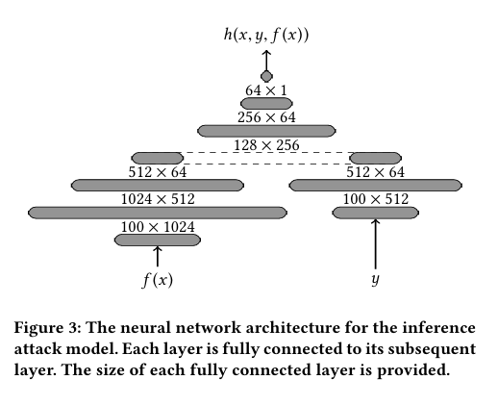
Inference Model Architecture

Slide 46
Empirical Results

Slide 47
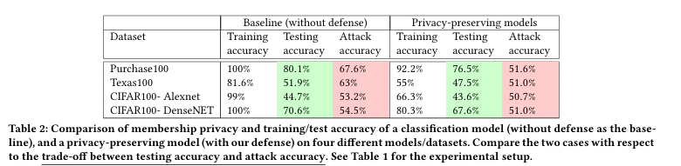
Key Results Overview

Slide 48
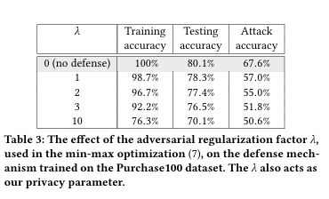
Key Results Overview (Adversarial Regulation Factor)

Slide 49
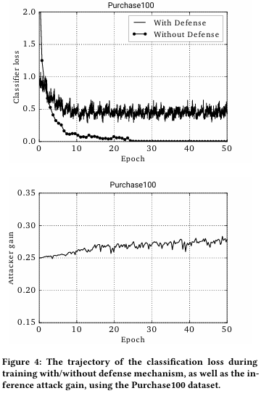
Classification Loss and Attacker Gain
Trajectories During Training (Purchase100):
Classification Loss:
With Defense: Stabilizes at lower values.
Without Defense: Decreases arbitrarily, risking overfitting.
Attacker Gain:
Without Defense: Remains higher across epochs.

Slide 50
Generalization Error With/Without Defense
Generalization error measures how well a machine learning model performs on unseen (test) data compared to the data it was trained on.
It reflects the difference between the model's performance on the training data and its performance on new data from the same distribution.
Models Without Defense:
Show higher generalization error across classes (curves lean right).
Models With Defense:
Lower generalization error, indicating better generalization across training and testing data.
Example:
Purchase100 With Defense: Error reduced from 29.7% to 7.5%.
Texas100: Reduced from 29.4% to 12.7%.
Takeaway: Privacy-preserving models generalize better, reducing overfitting and improving robustness.

Slide 51
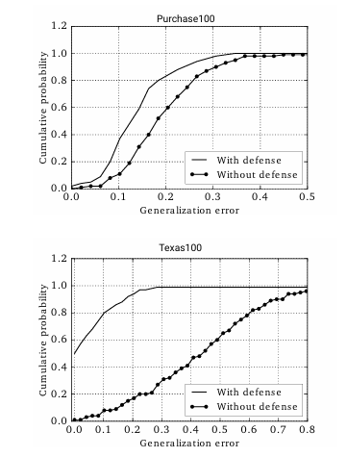
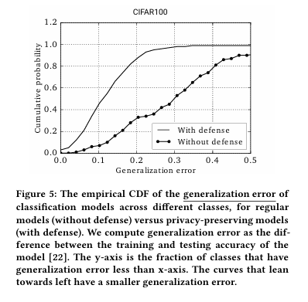

Slide 52
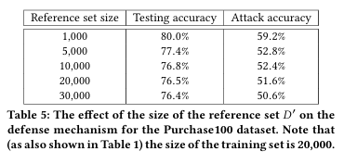
Reference Set Impact
Larger reference set size improves privacy by better representing the underlying distribution.
Example for Purchase100:
Reference Set = 1,000: Attack Accuracy = 59.2%.
Reference Set = 30,000: Attack Accuracy = 50.6%.
Key Insight:
Both 𝜆 and reference set size are critical for balancing privacy and accuracy.

Slide 53
Output Indistinguishability
Figure 6: Distribution of Prediction Probabilities (Purchase100):
Without Defense:
Classifier overconfident on training samples (close to 1 for specific classes).
With Defense:
Classifier spreads prediction probabilities across classes.
Training data indistinguishable from test data.
Takeaway:
Defense mechanism adds uncertainty, mitigating information leakage.

Slide 54
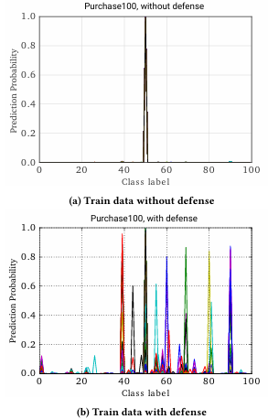
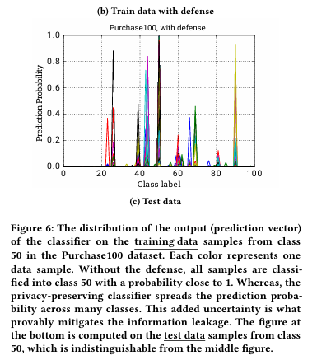

Slide 55
Member vs. Non-Member Accuracy
Prediction Accuracy (Figure 7):
Without Defense:
Clear gap between member and non-member accuracy.
With Defense:
Gap significantly reduced, closing the information leakage.
Prediction Uncertainty (Figure 8):
Without Defense:
Members have low uncertainty; non-members higher uncertainty.
With Defense:
Both members and non-members show similar uncertainty levels.
Takeaway:
Privacy-preserving models significantly reduce differences in prediction behavior for members and non-members.

Slide 56
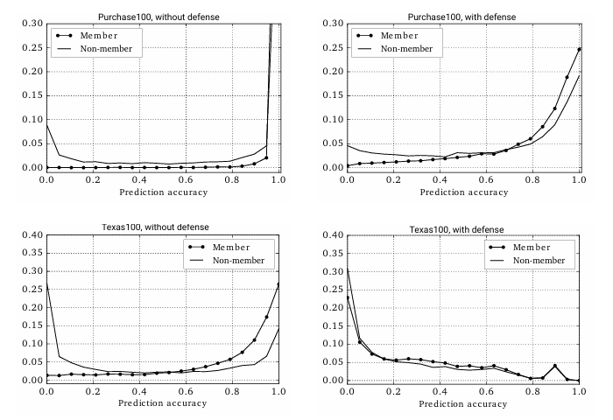
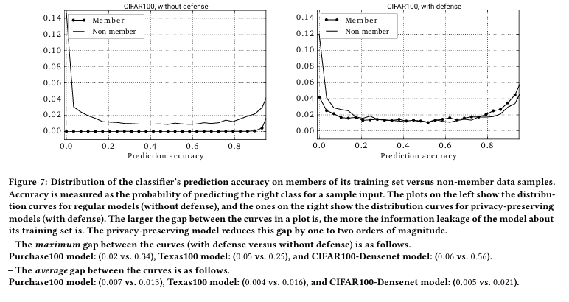

Slide 57
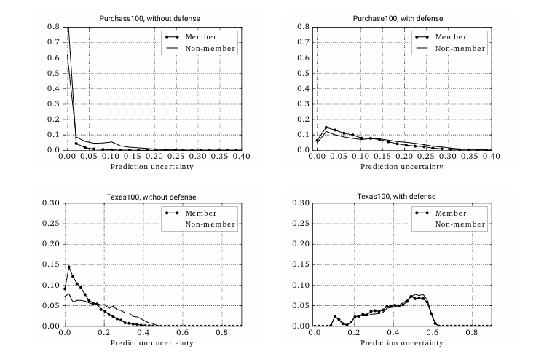
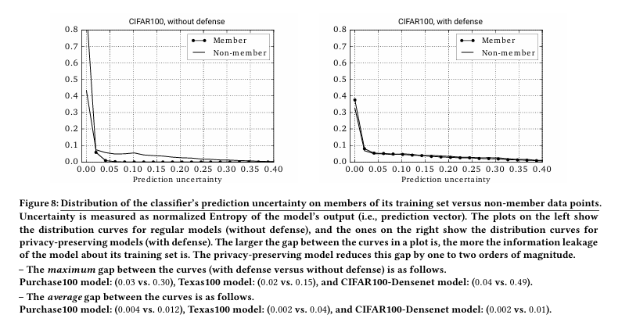

Slide 58
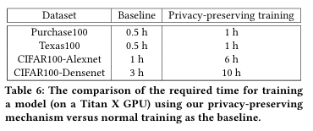
Training Time and Computational Feasibility
Privacy-preserving models require additional training time:
Increased due to the adversarial training mechanism.
Example: DenseNet on CIFAR100 increases from 3 hours to 10 hours.
Trade-off: More robust privacy and reduced attack accuracy.

Slide 59
Conclusion

Slide 60
Summary of Contributions
Developed a Privacy Mechanism:
Protects against membership inference attacks.
Ensures predictions on training data are indistinguishable from other data in the same distribution.
Optimization Framework:
Min-max game that balances:
Minimizing classification loss.
Limiting inference attack accuracy.
Generalization:
Privacy-preserving models generalize well across benchmark datasets.

Slide 61
Key Findings
Effectiveness:
Mechanism defends against the strongest membership inference attacks.
Ensures strong privacy guarantees with minimal impact on accuracy.
Experimental Validation:
Results across benchmark datasets (Purchase100, Texas100, CIFAR100) show:
Attack accuracy reduced to near random guessing.
Negligible drop in testing accuracy.
Practical Feasibility:
Computational cost is manageable with modern hardware.

Slide 62
Broader Implications
Impact on Machine Learning Privacy:
Demonstrates that robust privacy can be achieved without sacrificing utility.
Useful for sensitive applications (e.g., healthcare, finance, user data protection).
Future Work:
Exploring efficiency improvements in adversarial training.
Extending the mechanism to more complex models and datasets.

Slide 63
Citation
R. Shokri, M. Stronati, C. Song, and V. Shmatikov, "Membership inference attacks against machine learning models," in Proceedings of the 2017 ACM SIGSAC Conference on Computer and Communications Security (CCS '17), Dallas, TX, USA, Oct. 30–Nov. 3, 2017, pp. 3–18. DOI: 10.1145/3133956.3134019
Machine Learning with Membership Privacy using Adversarial Regularization

Slide 64
Thank You!
Questions?

